Slide 1
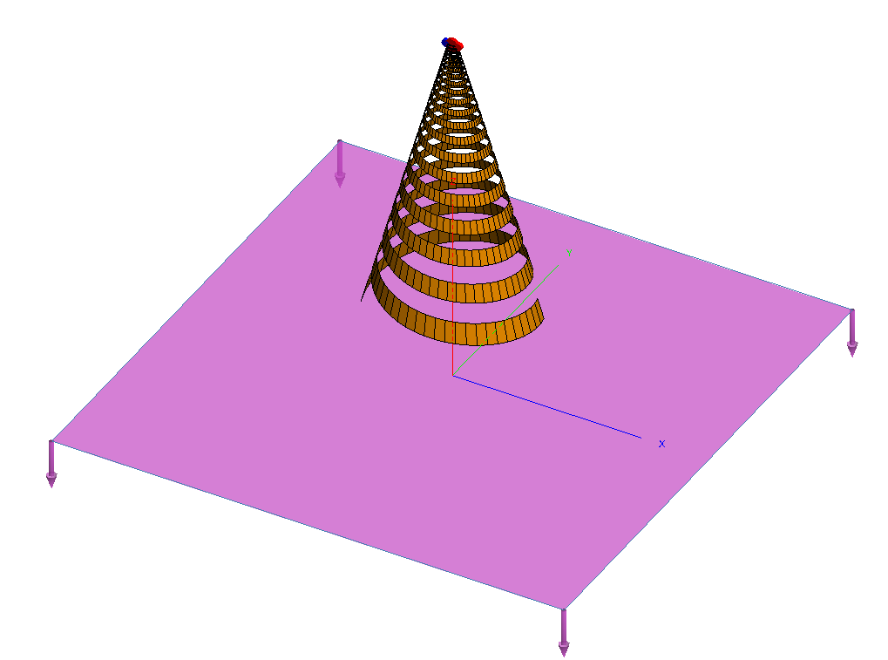
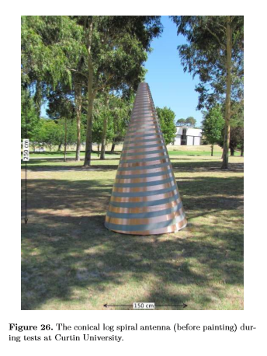

Conical log-spiral
$$f_{low}= 50MHz$$
Bandwidth (and chromaticity) => inner and outer cone radius
Front-to-back radiation ratio => wrap and cone angles
Sokolowski et al., “BIGHORNS – Broadband Instrument for Global HydrOgen ReioNisation Signal”, PASA 2015
no ground plane (*) ? infinite balun ?
(*) “Conical Spiral Antennas for EoR applications”, Curtin university & Astron 2012

Slide 2
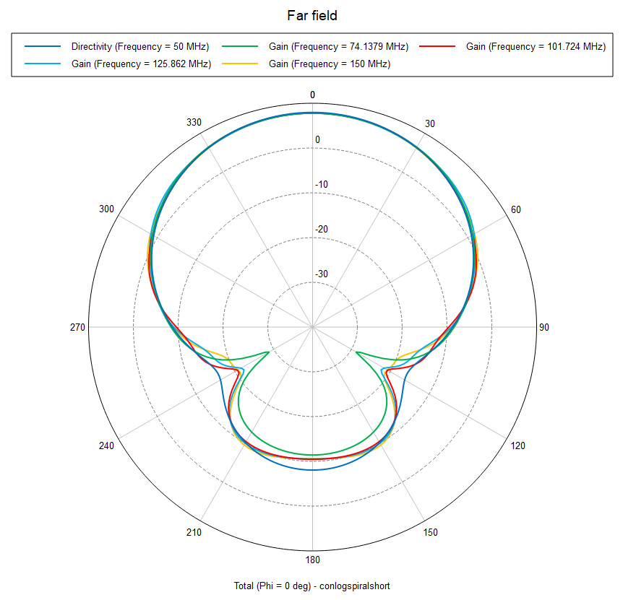
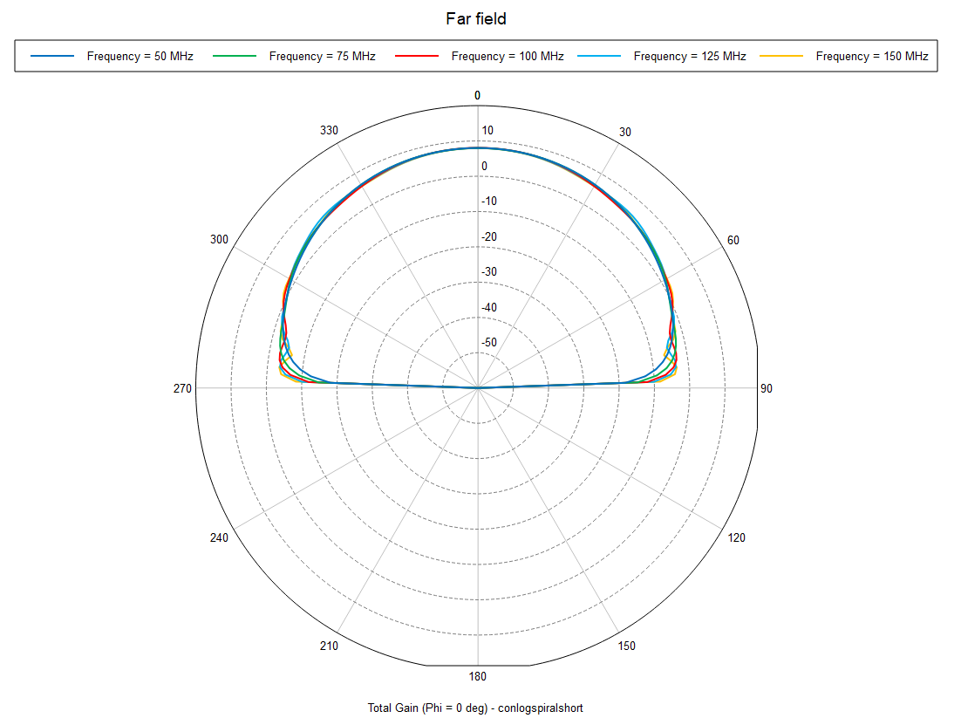
Patterns
No ground
Above EDGES soil

Slide 3
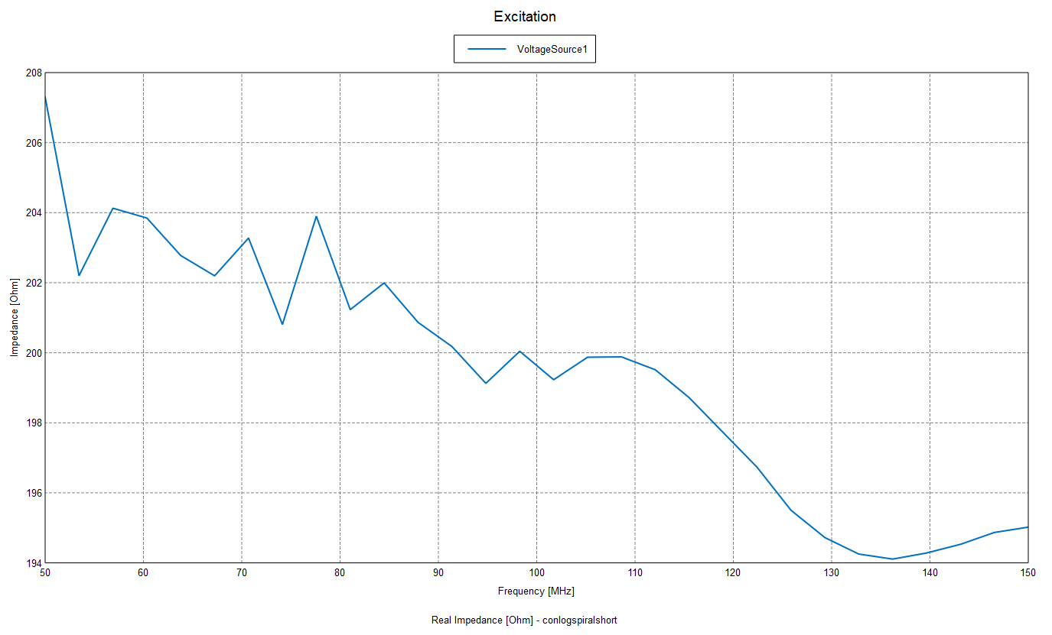
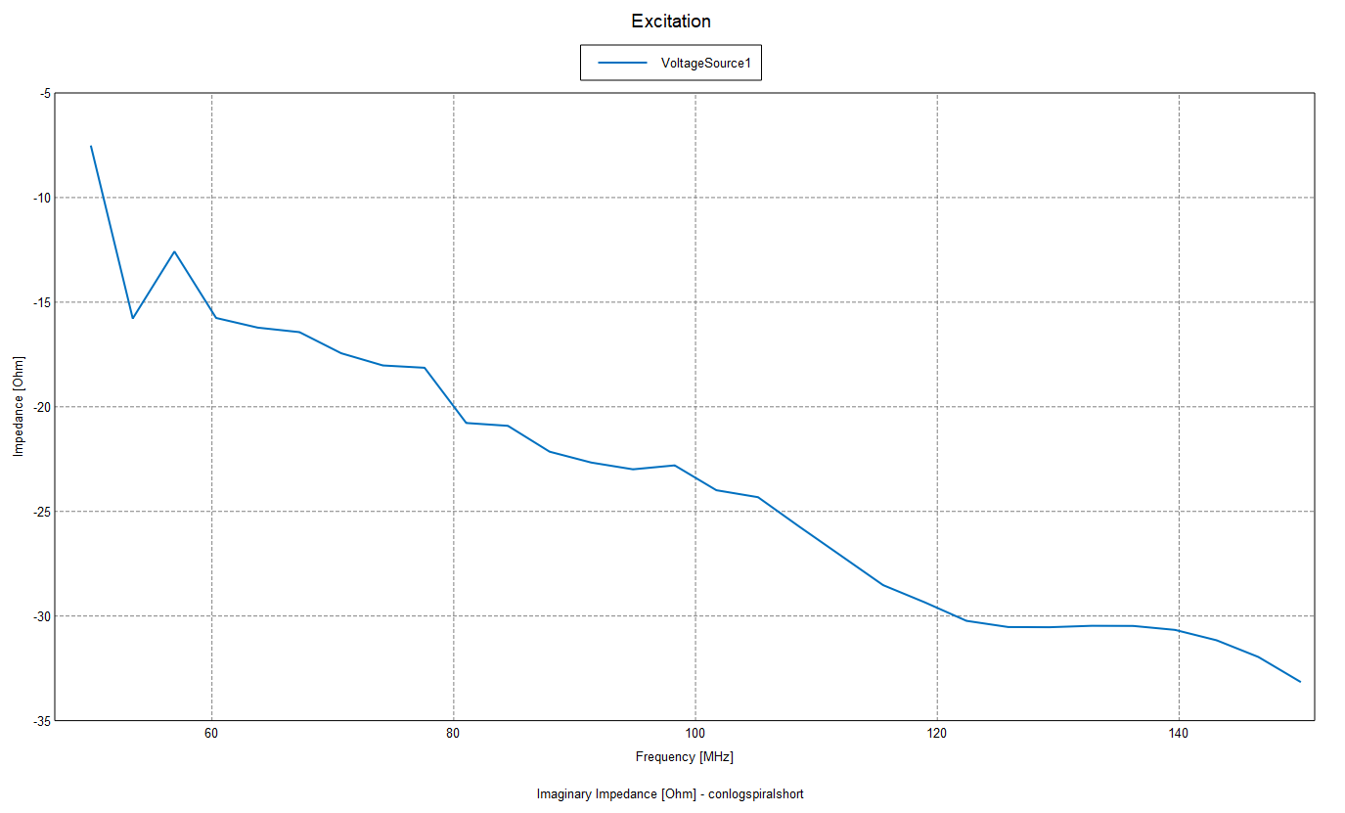

Impedance (over soil)
Real(Z)
Imag(Z)
$$10 Ohm$$

